Slide 1
Host Developer Template
DELETE THIS SLIDE BEFORE PRESENTING
PLEASE DON’T CHANGE ANYTHING. MAKE A COPY

Slide 2
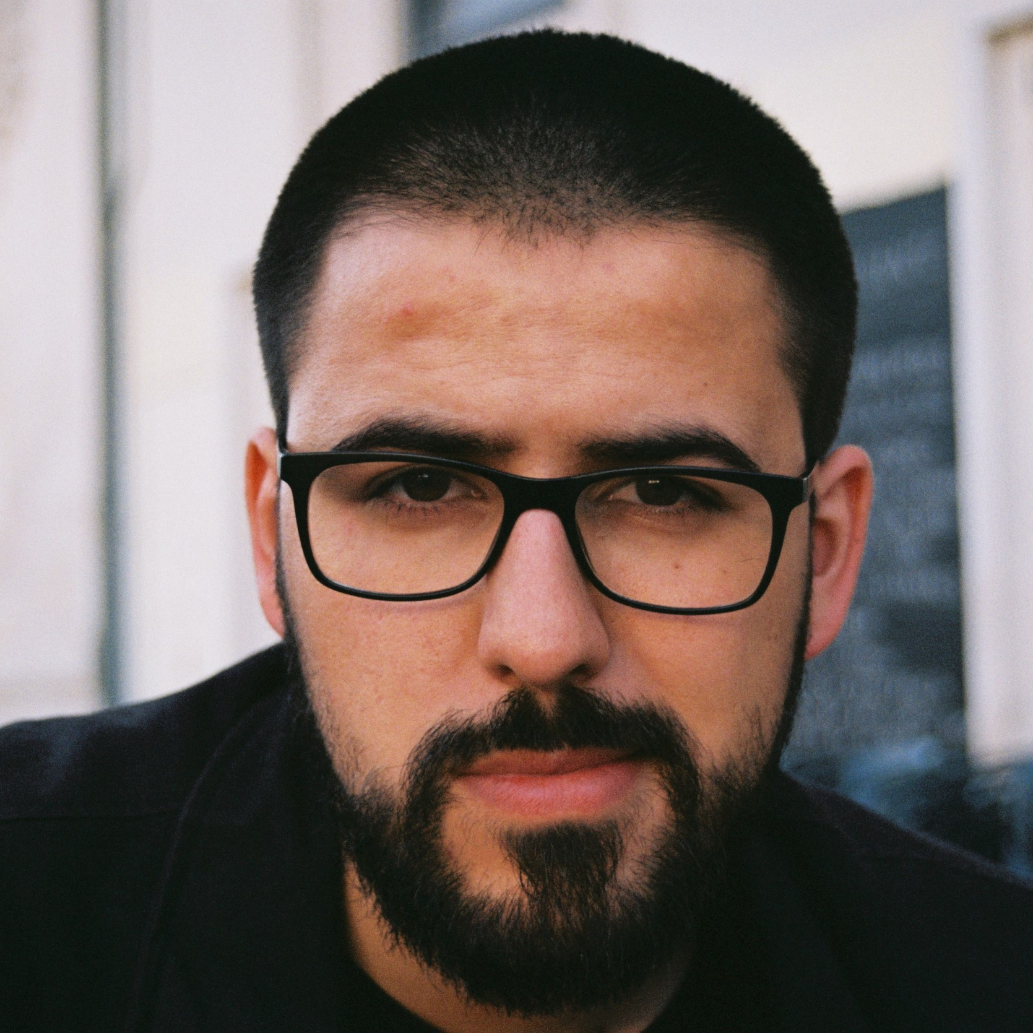
Use this Layout to select your own Neo
You can easily Right Click and Replace Image using the Neo’s available on the Brand Folder
Speaker Name
Speaker Role @ Company Name

Slide 3
Short Titles are Cool but People usually write much more
And that’s why we have subtitles, to create hierarchy, split information
Speaker Name
Speaker Role @ Company Name

Slide 4
Short Titles are Cool but People usually write much more
And that’s why we have subtitles, to create hierarchy, split information
Speaker Name
Speaker Role @ Company Name

Slide 5
Short Titles are Cool but People usually write much more
And that’s why we have subtitles, to create hierarchy, split information
Speaker Name
Speaker Role @ Company Name

Slide 6
Short Titles are Cool but People usually write much more
And that’s why we have subtitles, to create hierarchy, split information
Speaker Name
Speaker Role @ Company Name

Slide 7
Short Titles are Cool but People usually write much more
And that’s why we have subtitles, to create hierarchy, split information
Speaker Name
Speaker Role @ Company Name

Slide 8
Rules of Engagement
🔇 - The event has a webinar format, so microphones and cameras are not enabled.
🙋 - Have a question/comment? Drop it in the Q&A!
🌎 - Let us know in the chat where you are joining from!
⏺️ - This meeting will be recorded and shared on the event page ~one week after the event.
📝 - Want to provide feedback? Fill out our feedback survey! You will get it on your email post-event.

Slide 9

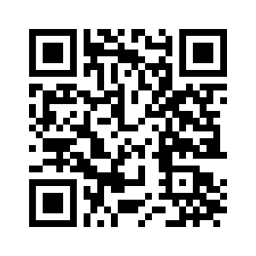
A OutSystems Developer Conference está de volta e maior do que nunca!
Mais sessões. Mais chances de experimentar novos recursos na prática. Mais formas de se conectar com a comunidade.
Denver, USA | 21-22 Junho
Lisboa, Portugal | 12-13 Setembro
Bangalore, India | Brevemente
Notes:
[Add to the chat]
If you would like to present a technical session about OutSystems or how OutSystems is used in your organization, submit your talk now 👉 https://usergroups.outsystems.com/call-for-speakers/
Who can submit a talk? Anyone!

Slide 10
The OutSystems Developer Conference is back and bigger than ever!
More sessions. More chances to try new features hands-on. More ways to connect with the OutSystems Developer Community.
Denver, USA | June 21-22
Lisboa, Portugal | September 12-13
Bengaluru, India | Coming Soon!
Notes:
[Add to the chat]
If you would like to present a technical session about OutSystems or how OutSystems is used in your organization, submit your talk now 👉 https://usergroups.outsystems.com/call-for-speakers/
Who can submit a talk? Anyone!

Slide 11
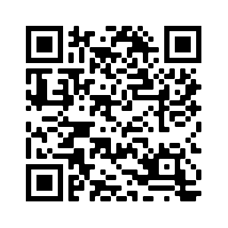
Call for Speakers
If you would like to present a technical talk about OutSystems or how OutSystems is used in your organization, submit your session now.
Who can submit a talk? Anyone!
Notes:
[Add to the chat]
If you would like to present a technical session about OutSystems or how OutSystems is used in your organization, submit your talk now 👉 https://usergroups.outsystems.com/call-for-speakers/
Who can submit a talk? Anyone!

Slide 12
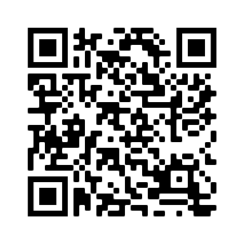
Become an OutSystems User Group Organizer!
We are looking for people to drive the [city] User Group. If you want to be the face of your local community, help drive local events, get perks and have lots of fun while doing it, then this is for you.
Apply now!
Notes:
[Add to the chat]
If you would like to present a technical session about OutSystems or how OutSystems is used in your organization, submit your talk now 👉 https://usergroups.outsystems.com/call-for-speakers/
Who can submit a talk? Anyone!

Slide 13
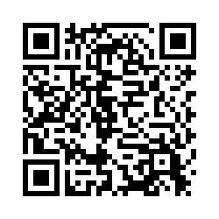
Join the OutSystems Research Program
Get involved in Product Development! Share your thoughts and opinions with us by participating in our research activities. You’ll be invited to contribute to the design decisions that really fit users' needs and help us build the future of software development.
→
→
1. Sign Up
2. Participate
3. Get Rewarded
Apply to join the OutSystems Research Program
Take part in a study you’ve
matched with
Receive compensation or a small gift for sharing your thoughts
outsystems.com/our-community/research-program/

Slide 14
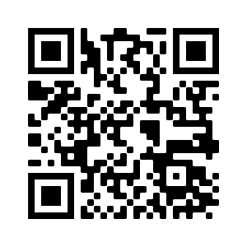
Feedback Survey
Thank you for joining us in the OutSystems User Group!
Please fill this quick survey and let us know your thoughts - the good and the bad!

Slide 15
NeoMojis Sticker Sheet

Slide 16
Rules of Engagement
🔇 - Please remain on mute during presentations
📷 - Video cameras are welcomed!
🙋 - Have a question/comment? Drop it in the chat!
⏺️ - This meeting will be recorded and shared on the event page one week after the event
📝 - Want to provide feedback? Fill out our User Group survey! You will get it on your email post-event.

Slide 17
Junte-se ao Programa de Pesquisa OutSystems
Envolva-se no desenvolvimento de produtos! Compartilhe seus pensamentos e opiniões conosco participando de nossas atividades de pesquisa. Você será convidado a contribuir com as decisões de design que realmente atendem às necessidades dos usuários e nos ajudam a construir o futuro do desenvolvimento de software.
→
→
1. Registre-se
2. Participe
3. Seja recompensado
Candidate-se ao Programa de Pesquisa OutSystems
Participe de um estudo que seja bom para você
Receba uma compensação ou um pequeno presente por compartilhar seus pensamentos
outsystems.com/our-community/research-program/

Slide 18
Únase al Programa de Investigación OutSystems
¡Participa en el desarrollo de productos! Comparta sus pensamientos y opiniones con nosotros participando en nuestras actividades de investigación. Se le invitará a contribuir con las decisiones de diseño que realmente se adapten a las necesidades de los usuarios y nos ayude a construir el futuro del desarrollo de software.
→
→
1. Regístrate
2. Participa
3. Ser recompensado
Solicite unirse al programa de investigación de OutSystems
Participe en un estudio que tenga
combinado contigo
Reciba una compensación o un pequeño regalo por compartir sus pensamientos
outsystems.com/our-community/research-program/

